Slide 1
















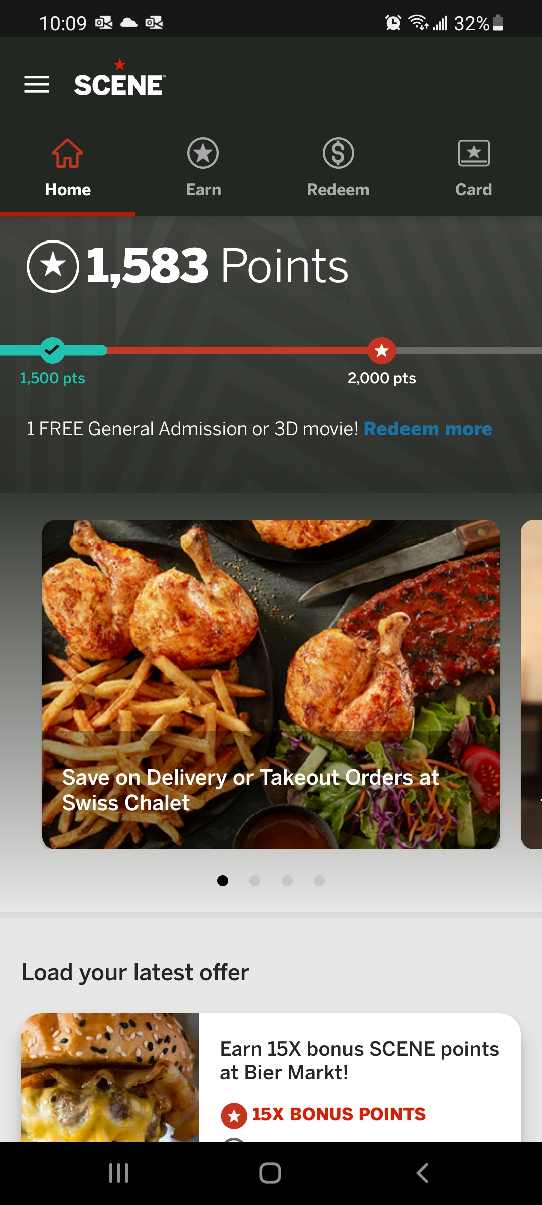

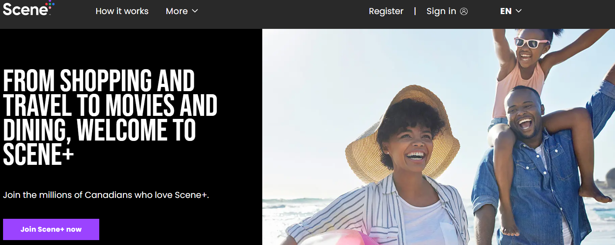
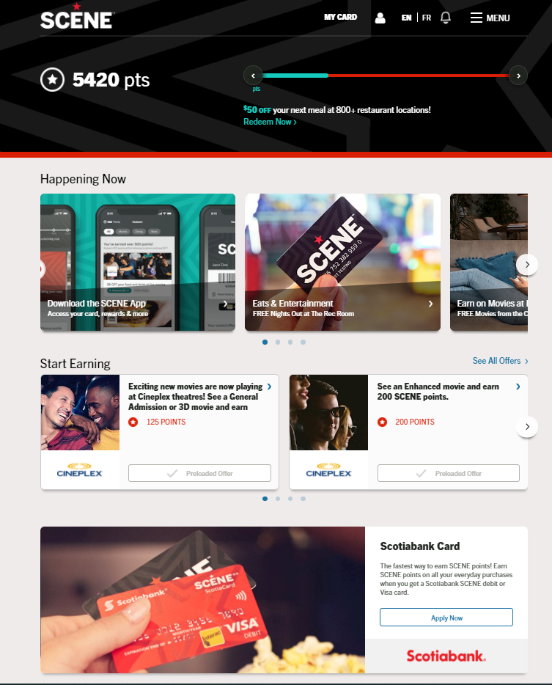




High-Level Component Data Flow
Firewall & Authentication
Processing Engine
Streaming
2.
Loyalty Engine
API Integration
Campaign Management
Base, Accelerated & Bonus Point Issuance
Manual Offer Prioritization
CRM
Base Point Calculation
POS Redemption
E-Commerce Redemption
Points Bank & Liability Management
1.
4.
Partner Streaming
Data Lake
3.
Customer
Service Manager
MFT
API Integration
API Integration
API Integration
MFT
Scene+ Website and App
Legend: Real-time Integration Batch (File) Integration API Integration flow

Slide 2
Data Flow #1: Partner Integration
New Member Demographic data/updates
Transactional data
Location data for points calculation
Transactional data
Location data for transaction association
Transactional data
Location data for transaction association
CRM
Point Calculation
POS Redemption
E-Commerce Redemption
Points Bank & Liability Management
Order data and status updates
Order data and status updates
Point issuance transactional data
Member linking/de-linking data
Point issuance transactional data
Member linking/de-linking data
Points redemption transactional data
Points issuance transactional data
API integration with SFMC marketing cloud to trigger operational emails and SMS opt-in/opt-out
Customer
Service Manager
New Member Demographic data/updates
Order updates
Scene+ Account and card updates
Adjustments
Disposition history
New Member Demographic data/updates
New Orders
Communication preferences/SMS Opt-in
Offer Opt-in/Opt-out
MFT
API integration to fetch data and content leveraging Agility content fetch API to display on digital properties
API integration with BH to submit GC orders and receive fulfillment and shipment updates
Offers, reward, events, spotlights, points
And order history impressions
Ecommerce impressions
Registration and profile updates
Scene+ Website and App
Content for website and app in eng and fr including images
Notes: Detailed data elements available in swagger and can be made available upon request, GA4 data resides in Google Analytics platform

Slide 3
Data Flow #2: Loyalty Engine to Synapze LX
2.
Campaign and member association data:
Mass and member targeted offers
Member offer opt-in/opt-out
Transactional data
Recipe earns
Empire redemptions
Home Hardware earn and redemptions (April)
Loyalty Engine
CRM
Base Point Calculation
POS Redemption
E-Commerce Redemption
Points Bank & Liability Management
Transactional data
Scotiabank earns
Cineplex earn and redemptions
Campaign Management
Base, Accelerated & Bonus Point Issuance
Manual Offer Prioritization
Offer issuance event is leveraged to issue points for batch campaigns
CampaignApprovedEvent: Event indicates that Campaign was Approved. Contains metadata of campaign, whether it's global and/or refreshable, Start/End date as well as information about selected audience and associated offers.
CampaignStatusChangedEvent: Event indicates that status of Campaign changed. Contains information about Campaign Status and Campaign Approval status
OfferAssignedEvent: Event indicates that certain member is eligible for an offer. Contains metadata of a Campaign and Assignment details
OfferIssuanceExpiredEvent: Event indicates that the issuance expired. Contains metadata of a Campaign, Assignment detail, Issuance details, and Coupon details
OfferIssuedEvent: Event indicates that reward was issued. Contains metadata of a Campaign, Assignment details, Issuance details, Cancelation and Reward details OfferOptedInEvent: Event indicates that member opted in/out from the eligible offer. Contains metadata of a Campaign Offer data, Opted In state, Opted In choice date. OfferRedeemedEvent: Event indicates that certain Voucher (Coupon) was used. Contains metadata of a Campaign, Offer data), Assignment details , Issuance Date, and Redemption details
Campaign and offer events are transformed for the purpose of partner streaming
MFT
Data Integration Exclusions:
Transactional data from Synapze to LE
  Recipe redemptions, Empire issuance, Rakuten issuance and all order redemptions (BYOT, PFC, Gift Cards, Expedia, Apple and Best Buy)
Omni-channel integration from LE to Synapze LX (deferred from MVP scope)
  Events triggering communication (emails/SMS) to members

Slide 4
Data Flow #3: Synapze LX to Data Lake
Data Lake
Scheduling Details: daily refresh. Exceptions: customer, points, and transaction tables are refreshed every 3 hours.
Members demographic data and profile updates
Scene+ account updates
All scene cards, their status and GK cards with attributes
BNS member profile data and updates
BNS accounts updates
Location data for partners
All look-up tables
Partner affiliation data
Communication preferences for members
Azure B2C logs (login, password resets, profile updates)
LE transformed events
Member activities log
API Logs
All partner earn and redemptions transactions
All partners earn and redemption points
All order redemptions
All account and portfolio point balances
Scene+ account updates
Partner affiliation data
Communication preferences for members
LE transformed events. All partner earn and redemptions transactions
All partners earn and redemption points
All order redemptions
All account and portfolio point balances
SFMC Files daily load from WTD
Location file for Empire
CRM
Base Point Calculation
POS Redemption
E-Commerce Redemption
Points Bank & Liability Management
SQL events through CDC streaming
Cosmos events through cosmos streaming
Azure B2C Logs
LE events
CSM events
Streaming
SFMC Files daily load from WTD
Location file for Empire
Empire Tlogs
Members demographic data and profile updates
MFT
Members demographic data and profile updates
All scene cards, their status and GK cards with attributes
Location data for partners
All partner earn and redemptions transactions
All order redemptions
SFMC Files daily load from WTD
1. Exclusions Core to Raw:
Data elements from transformed LE events (e.g. campaign status, mass offer assignment)
Email request data
2. Exclusions Raw to Silver:
audit_bns_plastichistory,core_bns_customer,,core_bns_customeraccount,core_customercontact (in pii), core_customerprimaryaddress (in pii) core_loyaltycardrequest
+ Tlogs: Includes SKU level data for empire transactions and additional details related to Empire Stores (There are 15 tables in total which are included as a part of the Tlog)
*Additional details available in appendix.
Notes:
While not all data is available in the silver layer, Scene+ Analytics has access to Data Lake raw layer,
Offer/campaign reporting not in MVP scope
Information available in a certain layer indicates all pre-requisite layers would hold that information
Any information available in Gold will have a corresponding Power BI Report

Slide 5
Data Flow #4: Data Lake to Loyalty Engine
Data Lake
SyncMemberRequest
Event contains near real-time metadata regarding one of the 3 sections:
Member data (date of birth, postal code, status, etc)
Target level group data (sometimes called “product”. Account information such as Enrollment date, Type of the account, Code, Sub Code)
Loyalty Instrument data - binding between Member data and Target Level Group data as well as information about Ownership role, Primary account id, Enrollment date
Loyalty Engine
Campaign Management
Base, Accelerated & Bonus Point Issuance
Manual Offer Prioritization
Members demographic data and profile updates
member-profile:
File contains extract of information about members data and computed aggregates
Targetlevelgroup:
File contains extract of all information about target level groups and computed aggregates
Loyaltyinstrument:
File contains extract of all information about relationship between members and target level groups
control-load:
Metadata used to validate specific file ingestion run. Has references to member-profile, targetlevelgroup and loyaltyinstrument files
Data Recommendations for Targeting:
Empire issuance, Rakuten issuance and all order redemptions (BYOT, PFC, Gift Cards, Expedia, Apple and Best Buy)

